Slide 1
Context-based Diverse Image Colorization
Lingyi Ma & Muhua Xu
6.869 2022 Spring

Slide 2
Question Statement
Researchers had came to realize that colorization is a ill-posed problem as outputting a single colorization is denying the great possibilities of coloring. Thus, many current research develops probabilistic colorization model which produce multiple colorization from one grayscale input.
To automate the process, we aim to develop a model that would automatically choose the most realistic coloring from the multiple colorization output by understanding the context of the image from grayscale input.

Slide 3
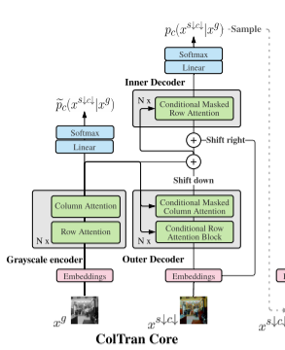
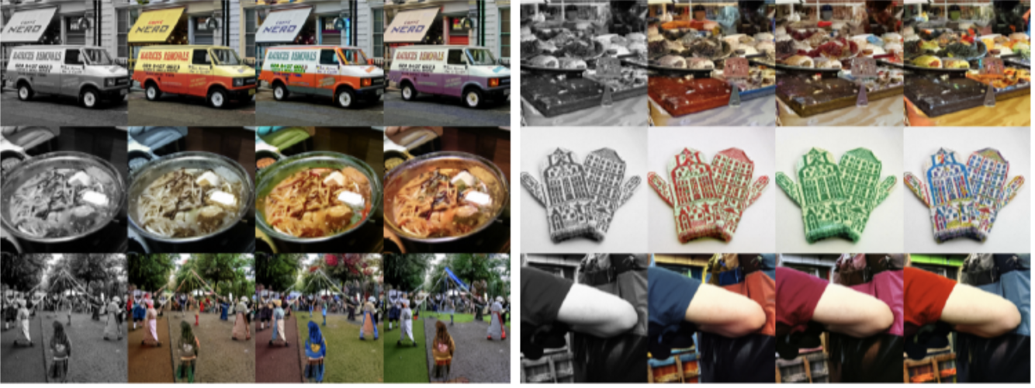
Related-Work
Colorization transformer - Probabilistic model that color images nondeterministically (Kumar, Weissenborn, and Kalchbrenner)
Source: coltran

Slide 4
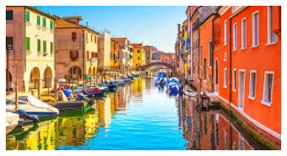
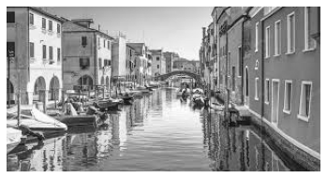
Proposed Method
Predict color information from gray image
[ mean & std of
rgb channel,
hsv channel,
yuv channel ]
Extract Statistics
Model
Notes:
h - hue, s - saturation, v - brightness. Hue is the main indication of color. It is the value actually telling you which color it is or the value that lets you go "red" when you see a red object.
Saturation is the perceived intensity, it is a value of how dominant the color is, or how colorful the object looks.
y - luma(luminance), u - blue-luma, v - red-luma

Slide 5
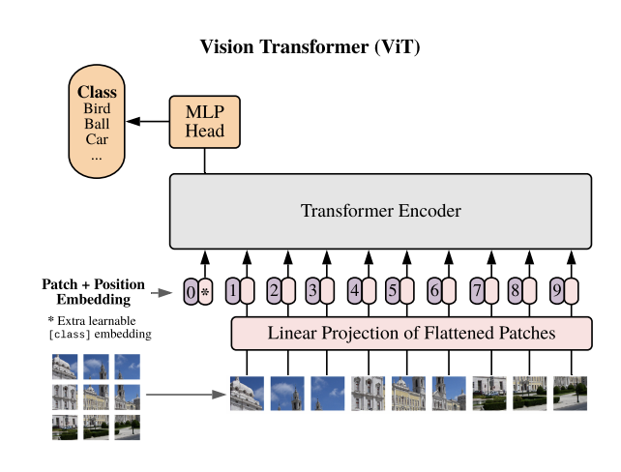
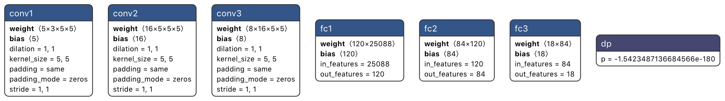
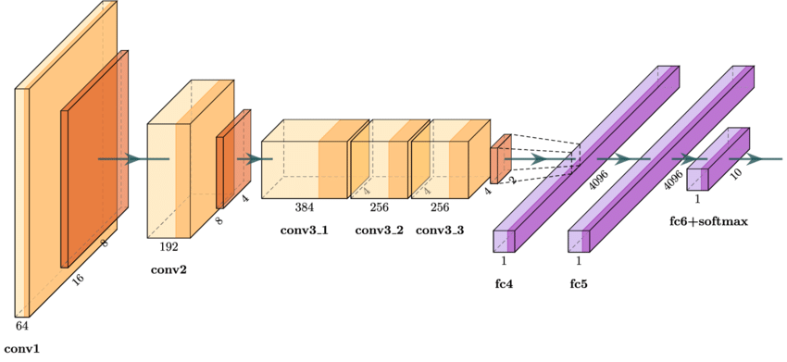
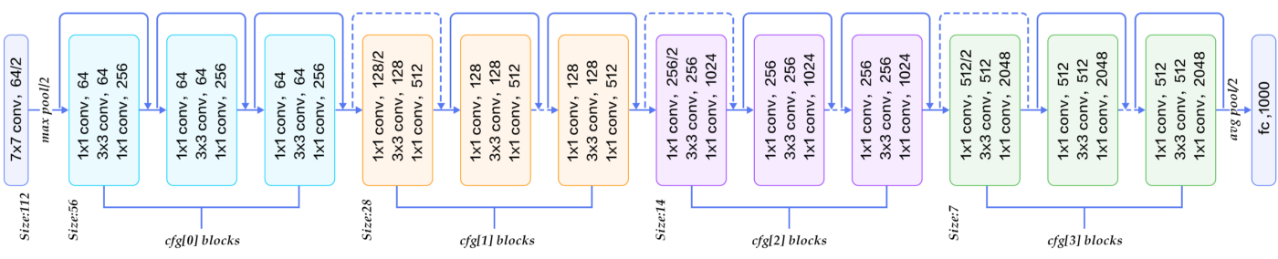

Models and Training process
Models: Dropnet, Alexnet, Resnet50, Vision Transformer small
Dropnet is a simple model modified from simple model in pset 5
Other models are pretrained, with last linear layer resized and retrained
Image preprocess: resized to 224 by 224 and normalized
Trained with Imagenet - val (50,000 images), each with 20 epochs

Slide 6
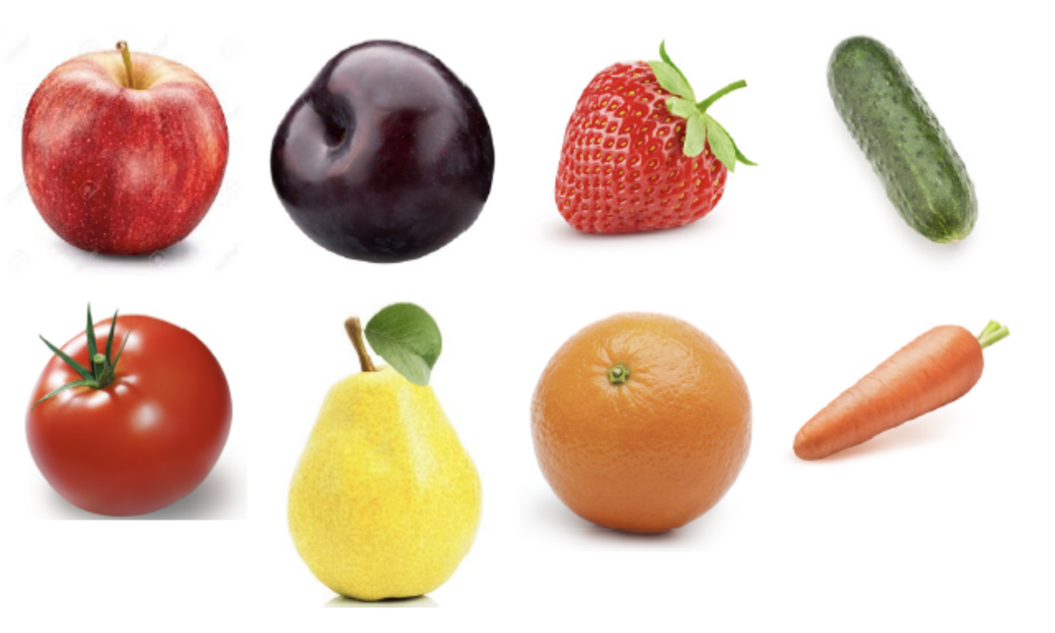
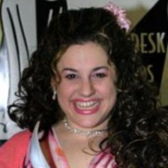
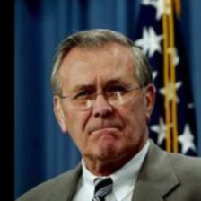
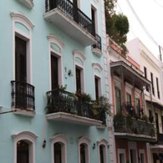
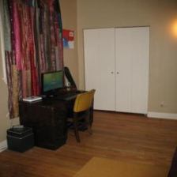
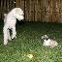

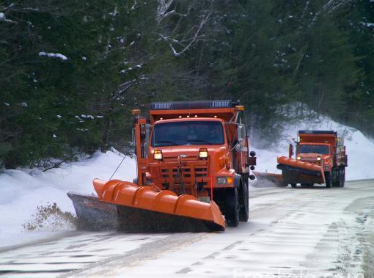
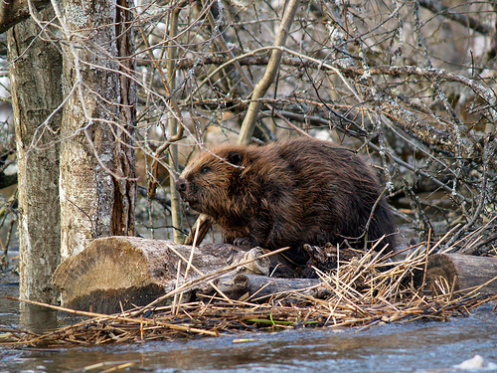
Evaluation Dataset
Natural color (NCD)
Source: GitHub - saeed-anwar/ColorSurvey: This repository is for "Image Colorization: A Survey and Dataset" paper
LFW - test
Places365 - val
Source: LFW Face Database : Main.
Source: Places dataset
Tiny Imagenet - test
Imagenet
Source: https://arxiv.org/pdf/1707.08819.pdf
Source: Imagenet Sample Image

Slide 7
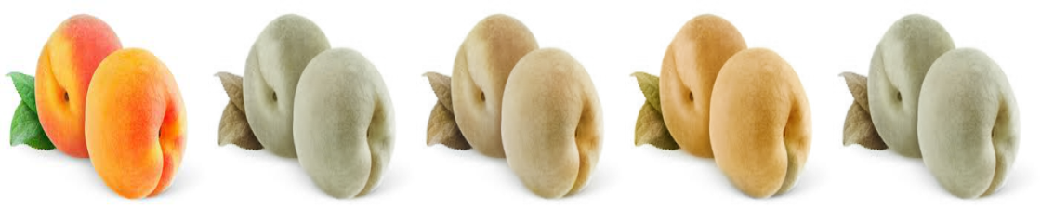
Results and Analysis
Loss on evaluation set:
Model: Resnet50 < Alexnet,ViT < Dropnet
Data set: LFW < Places365 < tiny Imagenet, NCD
Resnet50 choosed
Ground truth prediction 1 prediction 2 prediction 3 best

Slide 8
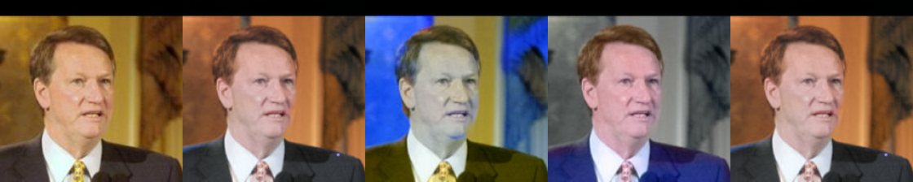
Results and Analysis
Loss on evaluation set:
Model: Resnet50 < Alexnet,ViT < Dropnet
Data set: LFW < Places365 < tiny Imagenet, NCD
Resnet50 choosed
Ground truth prediction 1 prediction 2 prediction 3 best

Slide 9
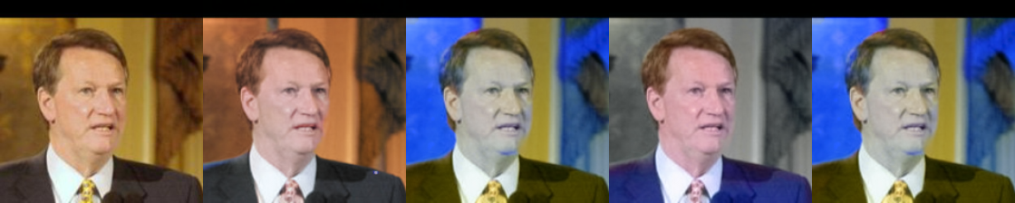
Results and Analysis
Loss on evaluation set:
Model: Resnet50 < Alexnet,ViT < Dropnet
Data set: LFW < Places365 < tiny Imagenet, NCD
Dropnet choosed
Ground truth prediction 1 prediction 2 prediction 3 best

Slide 10
Thanks for listening

